Slide 1
Python in the Built Environment
Dalton Goodwin
October 20, 2022

Slide 2

Introduction
Dalton Goodwin
Work at Henderson Engineers
Retail BIM TM (Technical Manager)
Have used Python for 4+ years
Working with design technology 6+ years
Experience in Architecture and Engineering
October 20, 2022
High-level programming language
Often used to build websites, software, automate tasks, and conduct data analysis
Use as a scripting or glue language to connect existing components together https://www.python.org/doc/essays/blurb/

Slide 3

Class Goals:
Inspire you to learn Python!
Show you some practical real examples
Give you ideas on how you can use Python
October 20, 2022
High-level programming language
Often used to build websites, software, automate tasks, and conduct data analysis
Use as a scripting or glue language to connect existing components together https://www.python.org/doc/essays/blurb/

Slide 4
Agenda
What is Python, and why does it matter?
Example 1: Duct Pressure Loss
Example 2: BIM Spent Report
Example 3: Visualizing Clash Data
Wrap-up and resources
October 20, 2022
High-level programming language
Often used to build websites, software, automate tasks, and conduct data analysis
Use as a scripting or glue language to connect existing components together https://www.python.org/doc/essays/blurb/

Slide 5

What is Python?
High-level programming language
Often used to build websites, software, automate tasks, and conduct data analysis
Use as a scripting or glue language to connect existing components together https://www.python.org/doc/essays/blurb/
What is Python, and why does it matter?
Example 1: Duct Pressure Loss
Example 2: BIM Spent Report
Example 3: Visualizing Clash Data
Wrap-up and resources
Why does it matter?
Many tools can be extended with code/low-code
Allow unique automation/processes not available through UI
Make life easier!
Notes:
Assembly and C are lower-level languages
Python is very similar to English!
Python is a high-level programming language designed to be easy to read and simple to implement. It is open source, which means it is free to use, even for commercial applications. Python can run on Mac, Windows, and Unix systems and has also been ported to Java and .NET virtual machines.
Python is a computer programming language often used to build websites and software, automate tasks, and conduct data analysis. Python is a general purpose language, meaning it can be used to create a variety of different programs and isn’t specialized for any specific problems. This versatility, along with its beginner-friendliness, has made it one of the most-used programming languages today.

Slide 6
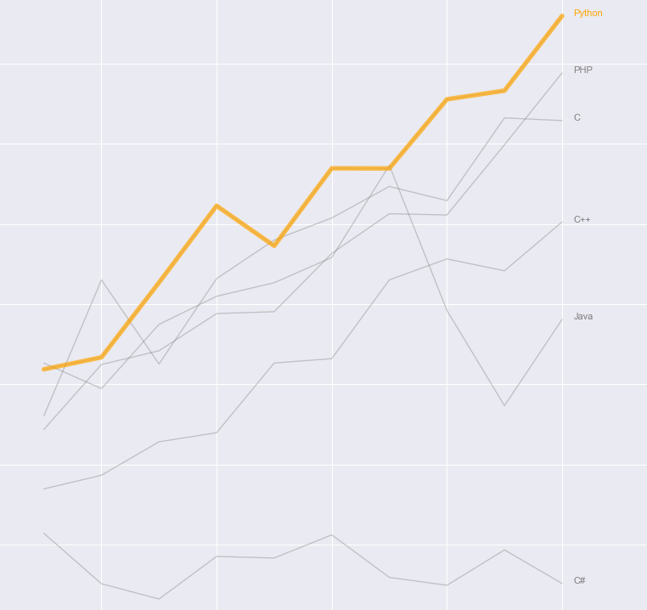
Why does it matter?
Many tools can be extended with code/low-code
Allow unique automation/processes not available through UI
Connect different tools
Make life easier with code!
Python Popularity
Notes:
Many tools can be extended with code/low-code
Grashopper
Dynamo
Revit
Allow unique automation/processes that leverage API functionality not available through the UI.
Duct module tool example
Fabrication example (Rods length)

Slide 7
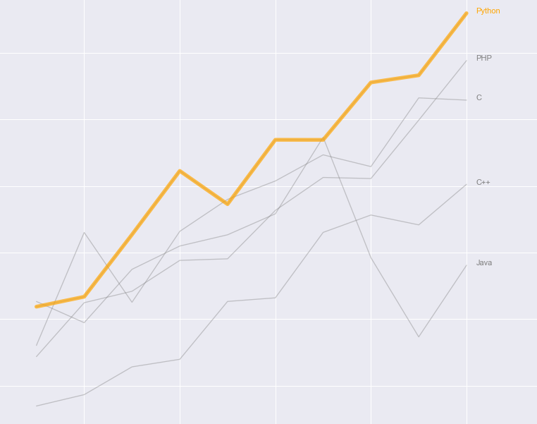
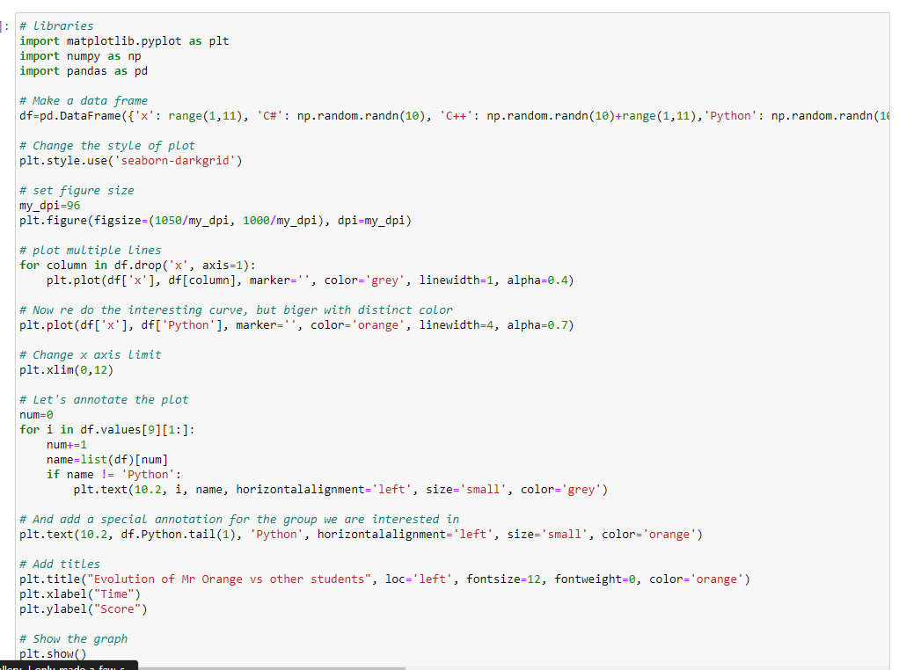

Why does it matter?
Many tools can be extended with code/low-code
Allow unique automation/processes not available through UI
Make life easier!
Python Popularity
Notes:
TIOBE Index: TIOBE ratings are calculated by counting hits of the most popular search engines. Twenty-five search engines are used to calculate the TIOBE index. The TIOBE Programming Community index is an indicator of the popularity of programming languages. The index started in the year 2001 and updated once a month.
PYPL Index: The PYPL PopularitY of Programming Language Index is created by analyzing how often language tutorials are searched on Google. The index is updated once a month.
https://statisticstimes.com/tech/top-computer-languages.php

Slide 8
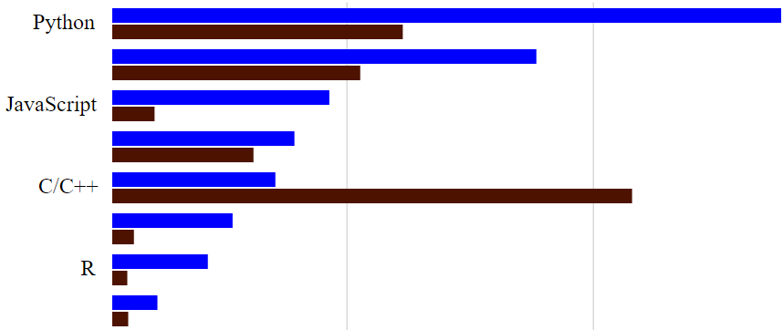
https://statisticstimes.com/tech/top-computer-languages.php
Python Popularity
Notes:
TIOBE Index: TIOBE ratings are calculated by counting hits of the most popular search engines. Twenty-five search engines are used to calculate the TIOBE index. The TIOBE Programming Community index is an indicator of the popularity of programming languages. The index started in the year 2001 and updated once a month.
PYPL Index: The PYPL PopularitY of Programming Language Index is created by analyzing how often language tutorials are searched on Google. The index is updated once a month.
https://statisticstimes.com/tech/top-computer-languages.php

Slide 9
https://statisticstimes.com/tech/top-computer-languages.php
What is Python, and why does it matter?
Example 1: Duct Pressure Loss
Example 2: BIM Spent Report
Example 3: Visualizing Clash Data
Wrap-up and resources
Notes:
TIOBE Index: TIOBE ratings are calculated by counting hits of the most popular search engines. Twenty-five search engines are used to calculate the TIOBE index. The TIOBE Programming Community index is an indicator of the popularity of programming languages. The index started in the year 2001 and updated once a month.
PYPL Index: The PYPL PopularitY of Programming Language Index is created by analyzing how often language tutorials are searched on Google. The index is updated once a month.
https://statisticstimes.com/tech/top-computer-languages.php

Slide 10
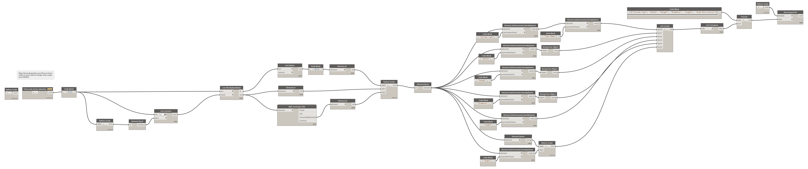
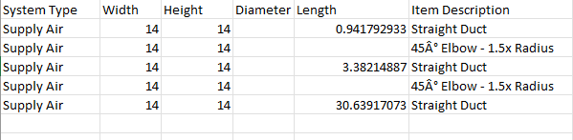
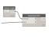
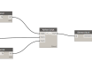
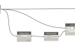
Example 1 of 3: Duct Pressure Loss (Dynamo and Python) Automation
Goal: To save time for the designer
Agenda
What is Python, and why does it matter?
Example 1: Duct Pressure Loss
Example 2: BIM Spent Report
Example 3: Visualizing Clash Data
Wrap-up and resources
October 20, 2022
October 20, 2022

Slide 11

What is Duct Pressure Loss?
Air resistance grows directly proportional to air flow. This phenomenon is known as pressure loss.
https://ventilation-system.com/what-is-pressure-loss
Example 1 of 3: Duct Pressure Loss (Dynamo and Python) Automation
Goal: To save time for the designer
Can we automate this?!
October 20, 2022
Notes:
This was to support a longer term of getting people into projects
Ensure system is fully closed
CFM filled in on all diffusers
Cap all open ends
Show disconnects
Check duct systems

Slide 12
Example 1 of 3: Duct Pressure Loss (Dynamo and Python) Automation
Goal: To save time for the designer
3
1
Can we automate this?!
October 20, 2022
2
Notes:
This was to support a longer term of getting people into projects
Ensure system is fully closed
CFM filled in on all diffusers
Cap all open ends
Show disconnects
Check duct systems

Slide 13
Live Demo 1 of 3: Duct Pressure Loss (Dynamo and Python) Automation
What is Duct Pressure Loss?
Air resistance grows directly proportional to air flow. This phenomenon is known as pressure loss.
https://ventilation-system.com/what-is-pressure-loss
Example 1 of 3: Duct Pressure Loss (Dynamo and Python) Automation
Goal: To save time for the designer
3
1
October 20, 2022
Can we automate this?!
2
October 20, 2022
Notes:
This was to support a longer term of getting people into projects
Ensure system is fully closed
CFM filled in on all diffusers
Cap all open ends
Show disconnects
Check duct systems
As air moves through a duct the air closest to the duct moves slower than air in middle of the duct due to friction. The friction impacts a static pressure drop that a fan needs to overcome to move air through the duct. We can calculate that pressure drop by knowing the air flow, the dimensions of the duct and the length of the duct run at that size. Every elbow, transition, takeoff, or other fitting on a duct run will also have a static pressure impact. We utilize formulas within a design standard (SMACNA) to help us determine what that static pressure value is.
Fans use electrical power to create a pressure differential across themselves (potential energy). This pressure differential causes air to flow down a duct (kinetic energy). As air travels down the duct obstructions will cause turbulence. Also, air moving against the inside of the duct will create friction. Both effects cause the available pressure (potential energy) to be reduced. This reduction in available pressure is called a “pressure drop” and we can calculate how much pressure is lost from each obstruction, transition, elbow, etc.

Slide 14
Do you need to learn to code?
Example 1 of 3: Duct Pressure Loss (Dynamo and Python) Automation
Goal: To save time for the designer
What is Duct Pressure Loss?
Air resistance grows directly proportional to air flow. This phenomenon is known as pressure loss.
https://ventilation-system.com/what-is-pressure-loss
3
I don’t think so!
Knowing when to speak up about an ineffective or inefficient process is just as important
Many wonderful visual tools available
2
1
October 20, 2022
Notes:
This was to support a longer term of getting people into projects
Ensure system is fully closed
CFM filled in on all diffusers
Cap all open ends
Show disconnects
Check duct systems

Slide 15

Actionable Takeaways:
Encourage “better” Revit modeling with automation
Create a communication channel for automation
Automating part of the process is the first step
Don’t be limited by the tools. Use the right tool for the job
October 20, 2022
Notes:
This was to support a longer term of getting people into projects
Ensure system is fully closed
CFM filled in on all diffusers
Cap all open ends
Show disconnects
Check duct systems
As air moves through a duct the air closest to the duct moves slower than air in middle of the duct due to friction. The friction impacts a static pressure drop that a fan needs to overcome to move air through the duct. We can calculate that pressure drop by knowing the air flow, the dimensions of the duct and the length of the duct run at that size. Every elbow, transition, takeoff, or other fitting on a duct run will also have a static pressure impact. We utilize formulas within a design standard (SMACNA) to help us determine what that static pressure value is.
Fans use electrical power to create a pressure differential across themselves (potential energy). This pressure differential causes air to flow down a duct (kinetic energy). As air travels down the duct obstructions will cause turbulence. Also, air moving against the inside of the duct will create friction. Both effects cause the available pressure (potential energy) to be reduced. This reduction in available pressure is called a “pressure drop” and we can calculate how much pressure is lost from each obstruction, transition, elbow, etc.

Slide 16
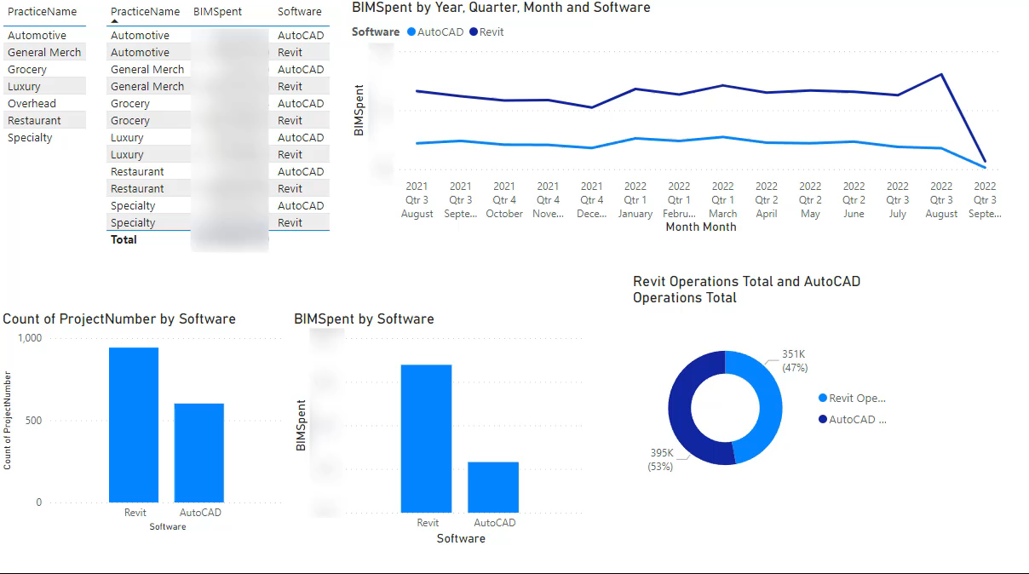
Example 2 of 3 : BIM Spent Report (Python and Power Bi)
Goal: To learn how Revit and AutoCAD are used
Agenda
What is Python, and why does it matter?
Example 1: Duct Static Loss
Example 2: BIM Spent Report
Example 3: Visualizing Clash Data
Wrap-up and resources
October 20, 2022
Example 2 of 3 : BIM Spent Report (Python and Power Bi)
Goal: To learn how Revit and AutoCAD are used
This will help guide our decisions across the sector
The data can be used to help show the success of Revit and automation
The data can be used to make sure we are heading to our goal of full Revit

Slide 17

Example 2 of 3 : BIM Spent Report (Python and Power Bi)
Goal: To learn how Revit and AutoCAD are used
This will help guide our decisions across the sector
The data can be used to help show the success of Revit and automation
The data can be used to make sure we are heading to our goal of full Revit
October 20, 2022
Notes:
This was to support a longer term of getting people into projects
Jupyter notebook is a wonderful way to show the thought process

Slide 18
Example 2 of 3 : BIM Spent Report (Python and Power Bi)
Goal: To learn how Revit and AutoCAD are used
October 20, 2022
Notes:
This was to support a longer term of getting people into projects
Jupyter notebook is a wonderful way to show the thought process

Slide 19

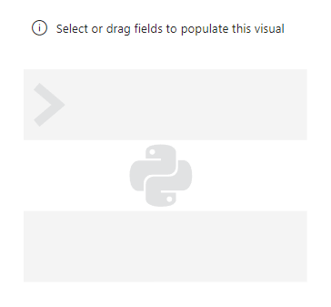
Data Used:
Labor spent
Software usage (Revit and AutoCAD)
Per person on project
Project numbers
Project_software
Example 2 of 3 : BIM Spent Report (Python and Power Bi)
Goal: To learn how Revit and AutoCAD are used
October 20, 2022
Notes:
This was to support a longer term of getting people into projects
Jupyter notebook is a wonderful way to show the thought process

Slide 20
Data Used:
Labor spent
Software usage (Revit and AutoCAD)
Per person on project
Project numbers
Project_software
Example 2 of 3 : BIM Spent Report (Python and Power Bi)
Goal: To learn how Revit and AutoCAD are used
October 20, 2022
Notes:
This was to support a longer term of getting people into projects
Jupyter notebook is a wonderful way to show the thought process

Slide 21

Data Used:
Labor spent (Labor db SQL)
Software usage (Usage db SQL)
Per person on project
Project numbers (Project db SQL)
Project_software (Custom data)
October 20, 2022
Notes:
This was to support a longer term of getting people into projects
Ensure system is fully closed
CFM filled in on all diffusers
Cap all open ends
Show disconnects
Check duct systems
As air moves through a duct the air closest to the duct moves slower than air in middle of the duct due to friction. The friction impacts a static pressure drop that a fan needs to overcome to move air through the duct. We can calculate that pressure drop by knowing the air flow, the dimensions of the duct and the length of the duct run at that size. Every elbow, transition, takeoff, or other fitting on a duct run will also have a static pressure impact. We utilize formulas within a design standard (SMACNA) to help us determine what that static pressure value is.
Fans use electrical power to create a pressure differential across themselves (potential energy). This pressure differential causes air to flow down a duct (kinetic energy). As air travels down the duct obstructions will cause turbulence. Also, air moving against the inside of the duct will create friction. Both effects cause the available pressure (potential energy) to be reduced. This reduction in available pressure is called a “pressure drop” and we can calculate how much pressure is lost from each obstruction, transition, elbow, etc.

Slide 22

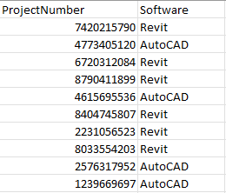
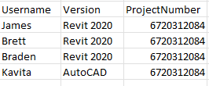
Data Used:
Labor spent (Labor db SQL)
Software usage (Usage db SQL)
Per person on project
Project numbers (Project db SQL)
Project_software (Custom data)
October 20, 2022
Notes:
This was to support a longer term of getting people into projects
Ensure system is fully closed
CFM filled in on all diffusers
Cap all open ends
Show disconnects
Check duct systems
As air moves through a duct the air closest to the duct moves slower than air in middle of the duct due to friction. The friction impacts a static pressure drop that a fan needs to overcome to move air through the duct. We can calculate that pressure drop by knowing the air flow, the dimensions of the duct and the length of the duct run at that size. Every elbow, transition, takeoff, or other fitting on a duct run will also have a static pressure impact. We utilize formulas within a design standard (SMACNA) to help us determine what that static pressure value is.
Fans use electrical power to create a pressure differential across themselves (potential energy). This pressure differential causes air to flow down a duct (kinetic energy). As air travels down the duct obstructions will cause turbulence. Also, air moving against the inside of the duct will create friction. Both effects cause the available pressure (potential energy) to be reduced. This reduction in available pressure is called a “pressure drop” and we can calculate how much pressure is lost from each obstruction, transition, elbow, etc.

Slide 23
Data Used:
Labor spent (Labor db SQL)
Software usage (Usage db SQL)
Per person on project
Project numbers (Project db SQL)
Project_software (Custom data)
October 20, 2022
Notes:
This was to support a longer term of getting people into projects
Ensure system is fully closed
CFM filled in on all diffusers
Cap all open ends
Show disconnects
Check duct systems
As air moves through a duct the air closest to the duct moves slower than air in middle of the duct due to friction. The friction impacts a static pressure drop that a fan needs to overcome to move air through the duct. We can calculate that pressure drop by knowing the air flow, the dimensions of the duct and the length of the duct run at that size. Every elbow, transition, takeoff, or other fitting on a duct run will also have a static pressure impact. We utilize formulas within a design standard (SMACNA) to help us determine what that static pressure value is.
Fans use electrical power to create a pressure differential across themselves (potential energy). This pressure differential causes air to flow down a duct (kinetic energy). As air travels down the duct obstructions will cause turbulence. Also, air moving against the inside of the duct will create friction. Both effects cause the available pressure (potential energy) to be reduced. This reduction in available pressure is called a “pressure drop” and we can calculate how much pressure is lost from each obstruction, transition, elbow, etc.

Slide 24
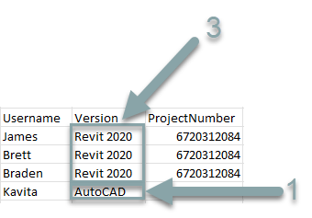
Data Used:
Labor spent (Labor db SQL)
Software usage (Usage db SQL)
Per person on project
Project numbers (Project db SQL)
Project_software (Custom data)
October 20, 2022
Notes:
This was to support a longer term of getting people into projects
Ensure system is fully closed
CFM filled in on all diffusers
Cap all open ends
Show disconnects
Check duct systems
As air moves through a duct the air closest to the duct moves slower than air in middle of the duct due to friction. The friction impacts a static pressure drop that a fan needs to overcome to move air through the duct. We can calculate that pressure drop by knowing the air flow, the dimensions of the duct and the length of the duct run at that size. Every elbow, transition, takeoff, or other fitting on a duct run will also have a static pressure impact. We utilize formulas within a design standard (SMACNA) to help us determine what that static pressure value is.
Fans use electrical power to create a pressure differential across themselves (potential energy). This pressure differential causes air to flow down a duct (kinetic energy). As air travels down the duct obstructions will cause turbulence. Also, air moving against the inside of the duct will create friction. Both effects cause the available pressure (potential energy) to be reduced. This reduction in available pressure is called a “pressure drop” and we can calculate how much pressure is lost from each obstruction, transition, elbow, etc.

Slide 25

Data Used:
Labor spent (Labor db SQL)
Software usage (Usage db SQL)
Per person on project
Project numbers (Project db SQL)
Project_software (Custom data)
October 20, 2022
Notes:
This was to support a longer term of getting people into projects
Ensure system is fully closed
CFM filled in on all diffusers
Cap all open ends
Show disconnects
Check duct systems
As air moves through a duct the air closest to the duct moves slower than air in middle of the duct due to friction. The friction impacts a static pressure drop that a fan needs to overcome to move air through the duct. We can calculate that pressure drop by knowing the air flow, the dimensions of the duct and the length of the duct run at that size. Every elbow, transition, takeoff, or other fitting on a duct run will also have a static pressure impact. We utilize formulas within a design standard (SMACNA) to help us determine what that static pressure value is.
Fans use electrical power to create a pressure differential across themselves (potential energy). This pressure differential causes air to flow down a duct (kinetic energy). As air travels down the duct obstructions will cause turbulence. Also, air moving against the inside of the duct will create friction. Both effects cause the available pressure (potential energy) to be reduced. This reduction in available pressure is called a “pressure drop” and we can calculate how much pressure is lost from each obstruction, transition, elbow, etc.

Slide 26
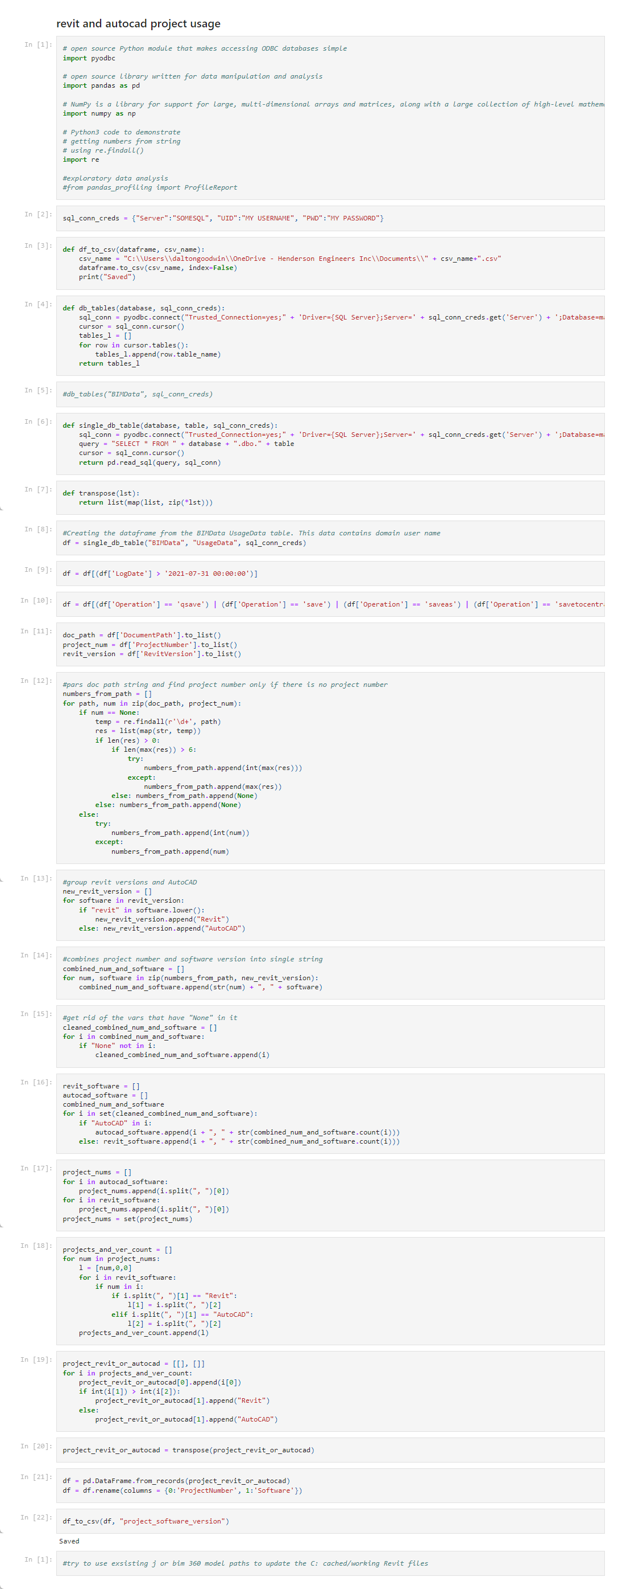
Notes:
This was to support a longer term of getting people into projects
Ensure system is fully closed
CFM filled in on all diffusers
Cap all open ends
Show disconnects
Check duct systems
As air moves through a duct the air closest to the duct moves slower than air in middle of the duct due to friction. The friction impacts a static pressure drop that a fan needs to overcome to move air through the duct. We can calculate that pressure drop by knowing the air flow, the dimensions of the duct and the length of the duct run at that size. Every elbow, transition, takeoff, or other fitting on a duct run will also have a static pressure impact. We utilize formulas within a design standard (SMACNA) to help us determine what that static pressure value is.
Fans use electrical power to create a pressure differential across themselves (potential energy). This pressure differential causes air to flow down a duct (kinetic energy). As air travels down the duct obstructions will cause turbulence. Also, air moving against the inside of the duct will create friction. Both effects cause the available pressure (potential energy) to be reduced. This reduction in available pressure is called a “pressure drop” and we can calculate how much pressure is lost from each obstruction, transition, elbow, etc.

Slide 27

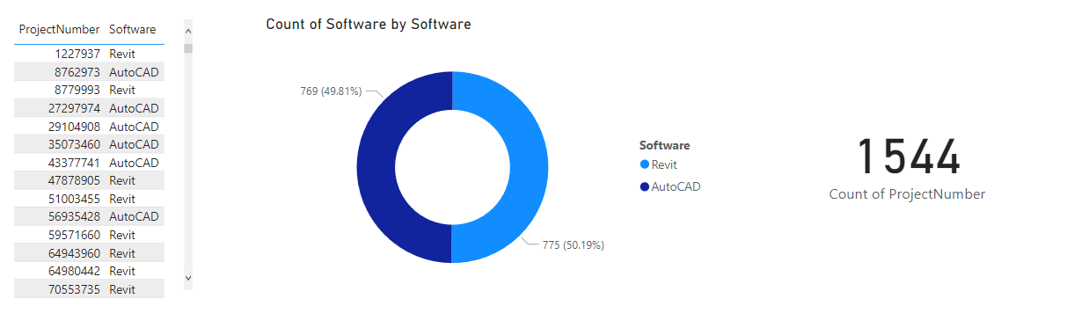
October 20, 2022
Notes:
This was to support a longer term of getting people into projects
Ensure system is fully closed
CFM filled in on all diffusers
Cap all open ends
Show disconnects
Check duct systems
As air moves through a duct the air closest to the duct moves slower than air in middle of the duct due to friction. The friction impacts a static pressure drop that a fan needs to overcome to move air through the duct. We can calculate that pressure drop by knowing the air flow, the dimensions of the duct and the length of the duct run at that size. Every elbow, transition, takeoff, or other fitting on a duct run will also have a static pressure impact. We utilize formulas within a design standard (SMACNA) to help us determine what that static pressure value is.
Fans use electrical power to create a pressure differential across themselves (potential energy). This pressure differential causes air to flow down a duct (kinetic energy). As air travels down the duct obstructions will cause turbulence. Also, air moving against the inside of the duct will create friction. Both effects cause the available pressure (potential energy) to be reduced. This reduction in available pressure is called a “pressure drop” and we can calculate how much pressure is lost from each obstruction, transition, elbow, etc.

Slide 28
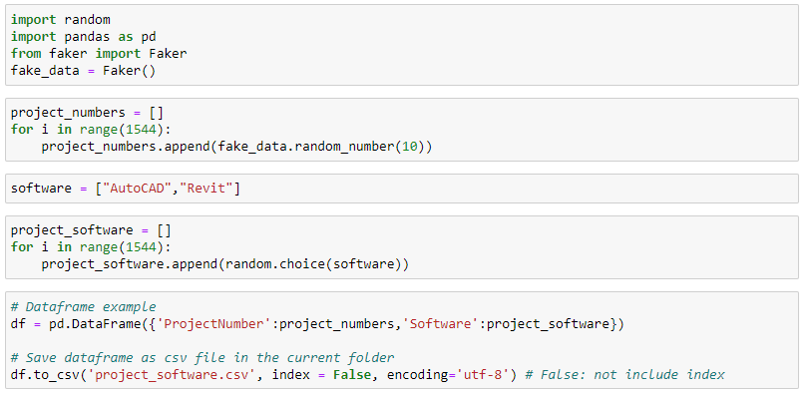
October 20, 2022
Data Used:
Labor spent
Software usage (Revit and AutoCAD)
Per person on project
Project numbers
Project_software
Notes:
This was to support a longer term of getting people into projects
Ensure system is fully closed
CFM filled in on all diffusers
Cap all open ends
Show disconnects
Check duct systems
As air moves through a duct the air closest to the duct moves slower than air in middle of the duct due to friction. The friction impacts a static pressure drop that a fan needs to overcome to move air through the duct. We can calculate that pressure drop by knowing the air flow, the dimensions of the duct and the length of the duct run at that size. Every elbow, transition, takeoff, or other fitting on a duct run will also have a static pressure impact. We utilize formulas within a design standard (SMACNA) to help us determine what that static pressure value is.
Fans use electrical power to create a pressure differential across themselves (potential energy). This pressure differential causes air to flow down a duct (kinetic energy). As air travels down the duct obstructions will cause turbulence. Also, air moving against the inside of the duct will create friction. Both effects cause the available pressure (potential energy) to be reduced. This reduction in available pressure is called a “pressure drop” and we can calculate how much pressure is lost from each obstruction, transition, elbow, etc.

Slide 29
October 20, 2022
Data Used:
Labor spent
Software usage (Revit and AutoCAD)
Per person on project
Project numbers
Project_software
Notes:
This was to support a longer term of getting people into projects
Ensure system is fully closed
CFM filled in on all diffusers
Cap all open ends
Show disconnects
Check duct systems
As air moves through a duct the air closest to the duct moves slower than air in middle of the duct due to friction. The friction impacts a static pressure drop that a fan needs to overcome to move air through the duct. We can calculate that pressure drop by knowing the air flow, the dimensions of the duct and the length of the duct run at that size. Every elbow, transition, takeoff, or other fitting on a duct run will also have a static pressure impact. We utilize formulas within a design standard (SMACNA) to help us determine what that static pressure value is.
Fans use electrical power to create a pressure differential across themselves (potential energy). This pressure differential causes air to flow down a duct (kinetic energy). As air travels down the duct obstructions will cause turbulence. Also, air moving against the inside of the duct will create friction. Both effects cause the available pressure (potential energy) to be reduced. This reduction in available pressure is called a “pressure drop” and we can calculate how much pressure is lost from each obstruction, transition, elbow, etc.

Slide 30
Actionable Takeaways:
Python can connect your different data sources
Many tools have Python integrations
Make data more accessible with Power BI and Python
October 20, 2022
Notes:
This was to support a longer term of getting people into projects
Ensure system is fully closed
CFM filled in on all diffusers
Cap all open ends
Show disconnects
Check duct systems
As air moves through a duct the air closest to the duct moves slower than air in middle of the duct due to friction. The friction impacts a static pressure drop that a fan needs to overcome to move air through the duct. We can calculate that pressure drop by knowing the air flow, the dimensions of the duct and the length of the duct run at that size. Every elbow, transition, takeoff, or other fitting on a duct run will also have a static pressure impact. We utilize formulas within a design standard (SMACNA) to help us determine what that static pressure value is.
Fans use electrical power to create a pressure differential across themselves (potential energy). This pressure differential causes air to flow down a duct (kinetic energy). As air travels down the duct obstructions will cause turbulence. Also, air moving against the inside of the duct will create friction. Both effects cause the available pressure (potential energy) to be reduced. This reduction in available pressure is called a “pressure drop” and we can calculate how much pressure is lost from each obstruction, transition, elbow, etc.

Slide 31
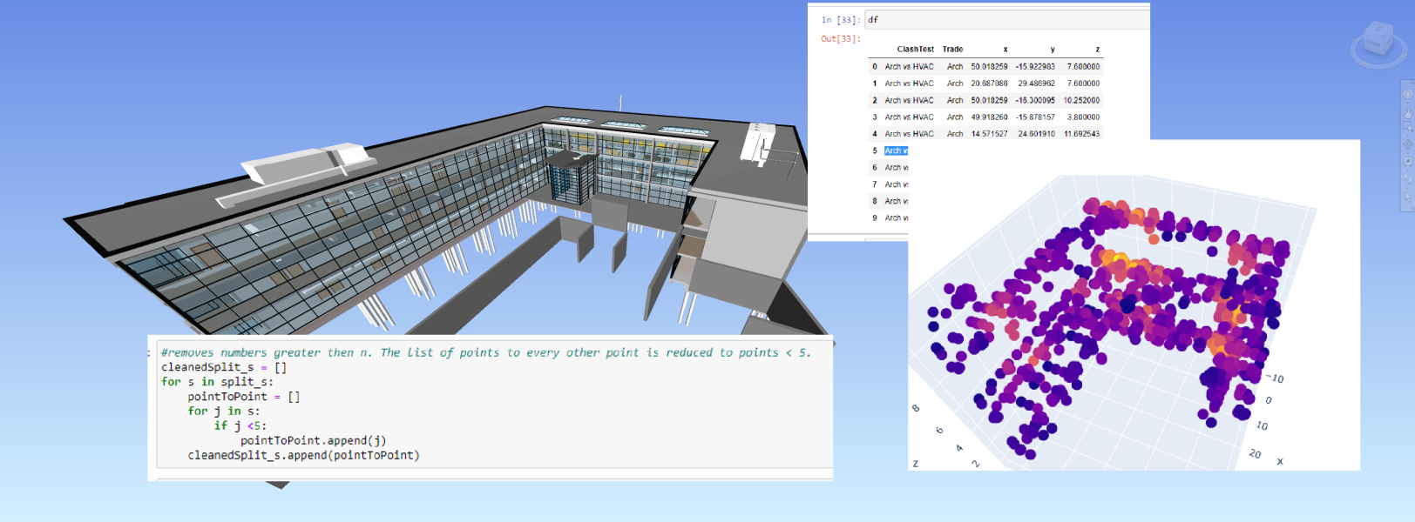
Example 3 of 3: Visualizing Clash Detection Data (Python)
Goal: Gain a better understanding of clashes on a project
Agenda
What is Python, and why does it matter?
Example 1: Duct Static Loss
Example 2: BIM Spent Report
Example 3: Visualizing Clash Data
Wrap-up and resources
October 20, 2022

Slide 32




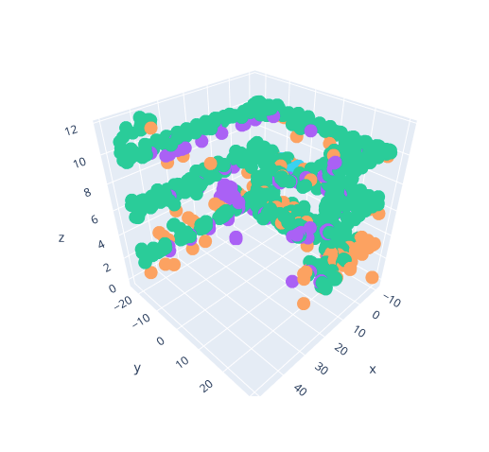
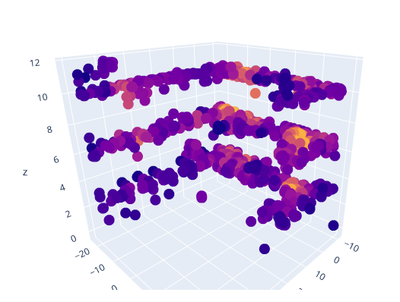
Example 3 of 3: Visualizing Clash Detection Data (Python)
Goal: Gain a better understanding of clashes on a project
October 20, 2022
Notes:
Revit, Dynamo, and Navisworks also used in this process.

Slide 33
Example 3 of 3: Visualizing Clash Detection Data (Python)
Goal: Gain a better understanding of clashes on a project
October 20, 2022
Notes:
Revit, Dynamo, and Navisworks also used in this process.

Slide 34
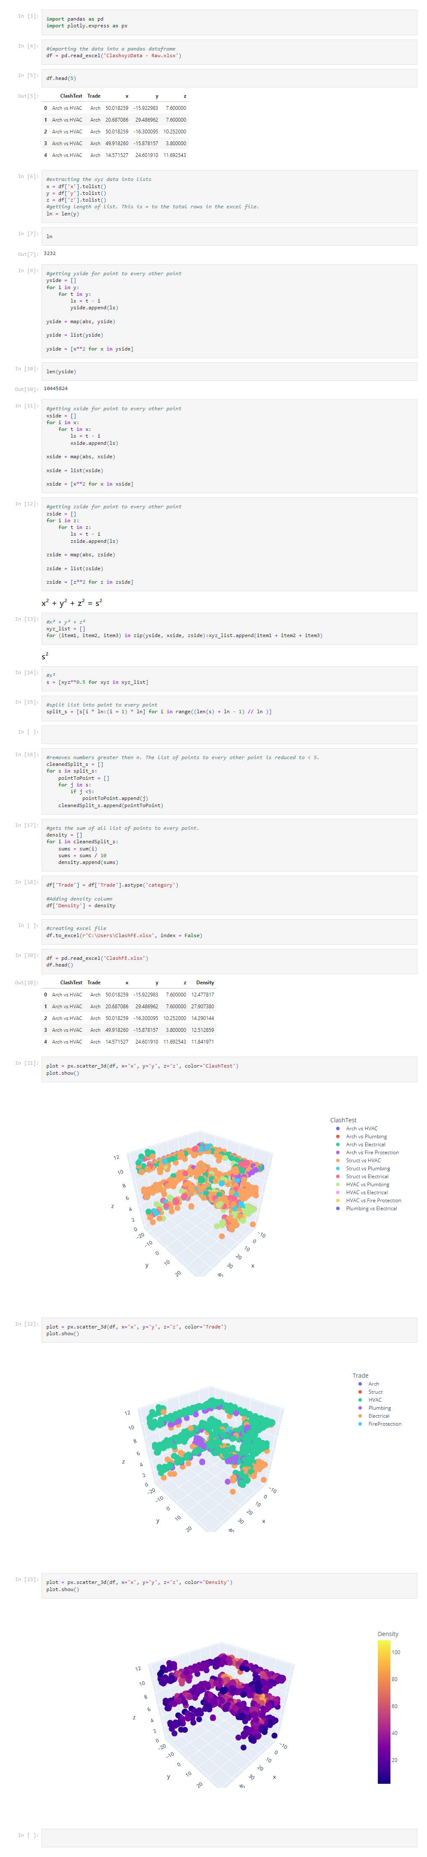
Notes:
This was to support a longer term of getting people into projects
Ensure system is fully closed
CFM filled in on all diffusers
Cap all open ends
Show disconnects
Check duct systems
As air moves through a duct the air closest to the duct moves slower than air in middle of the duct due to friction. The friction impacts a static pressure drop that a fan needs to overcome to move air through the duct. We can calculate that pressure drop by knowing the air flow, the dimensions of the duct and the length of the duct run at that size. Every elbow, transition, takeoff, or other fitting on a duct run will also have a static pressure impact. We utilize formulas within a design standard (SMACNA) to help us determine what that static pressure value is.
Fans use electrical power to create a pressure differential across themselves (potential energy). This pressure differential causes air to flow down a duct (kinetic energy). As air travels down the duct obstructions will cause turbulence. Also, air moving against the inside of the duct will create friction. Both effects cause the available pressure (potential energy) to be reduced. This reduction in available pressure is called a “pressure drop” and we can calculate how much pressure is lost from each obstruction, transition, elbow, etc.

Slide 35
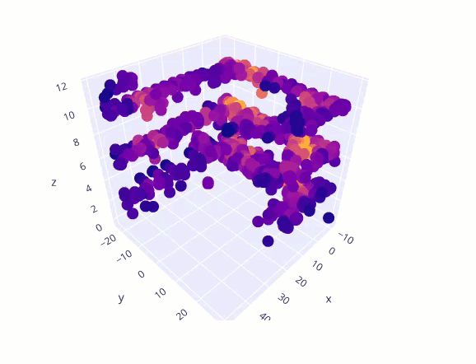
Notes:
This was to support a longer term of getting people into projects
Ensure system is fully closed
CFM filled in on all diffusers
Cap all open ends
Show disconnects
Check duct systems
As air moves through a duct the air closest to the duct moves slower than air in middle of the duct due to friction. The friction impacts a static pressure drop that a fan needs to overcome to move air through the duct. We can calculate that pressure drop by knowing the air flow, the dimensions of the duct and the length of the duct run at that size. Every elbow, transition, takeoff, or other fitting on a duct run will also have a static pressure impact. We utilize formulas within a design standard (SMACNA) to help us determine what that static pressure value is.
Fans use electrical power to create a pressure differential across themselves (potential energy). This pressure differential causes air to flow down a duct (kinetic energy). As air travels down the duct obstructions will cause turbulence. Also, air moving against the inside of the duct will create friction. Both effects cause the available pressure (potential energy) to be reduced. This reduction in available pressure is called a “pressure drop” and we can calculate how much pressure is lost from each obstruction, transition, elbow, etc.

Slide 36
Actionable Takeaways:
Use Python to view data in creative and interesting ways
October 20, 2022
Notes:
This was to support a longer term of getting people into projects
Ensure system is fully closed
CFM filled in on all diffusers
Cap all open ends
Show disconnects
Check duct systems
As air moves through a duct the air closest to the duct moves slower than air in middle of the duct due to friction. The friction impacts a static pressure drop that a fan needs to overcome to move air through the duct. We can calculate that pressure drop by knowing the air flow, the dimensions of the duct and the length of the duct run at that size. Every elbow, transition, takeoff, or other fitting on a duct run will also have a static pressure impact. We utilize formulas within a design standard (SMACNA) to help us determine what that static pressure value is.
Fans use electrical power to create a pressure differential across themselves (potential energy). This pressure differential causes air to flow down a duct (kinetic energy). As air travels down the duct obstructions will cause turbulence. Also, air moving against the inside of the duct will create friction. Both effects cause the available pressure (potential energy) to be reduced. This reduction in available pressure is called a “pressure drop” and we can calculate how much pressure is lost from each obstruction, transition, elbow, etc.

Slide 37
Agenda
What is Python, and why does it matter?
Example 1: Duct Static Loss
Example 2: BIM Spent Report
Example 3: Visualizing Clash Data
Wrap-up and resources
October 20, 2022

Slide 38



Do you need to learn to code?
I don’t think so! But it can help
Knowing when to speak up about an ineffective or inefficient process is just as important
Many excellent visual low code/no code tools are available
Notes:
Many tools can be extended with code/low-code
Grashopper
Dynamo
Revit
Allow unique automation/processes that leverage API functionality not available through the UI.
Duct module tool example
Fabrication example (Rods length)

Slide 39




Visual low code/no code tools
Dynamo
KNIME
Excel
SQL
Grasshopper
Power BI
Notes:
Many tools can be extended with code/low-code
Grashopper
Dynamo
Revit
Allow unique automation/processes that leverage API functionality not available through the UI.
Duct module tool example
Fabrication example (Rods length)

Slide 40
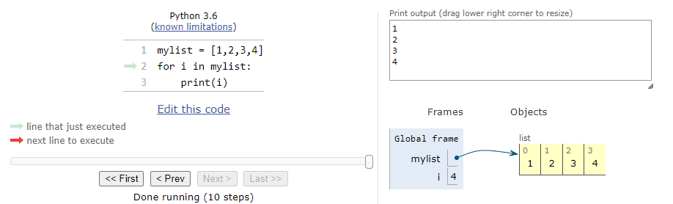
Where can you use Python?
Dynamo
KNIME
Excel
SQL
Grasshopper
Power BI
Notes:
Many tools can be extended with code/low-code
Grashopper
Dynamo
Revit
Allow unique automation/processes that leverage API functionality not available through the UI.
Duct module tool example
Fabrication example (Rods length)

Slide 41

Resources for learning Python:
Python Tutor:
https://pythontutor.com/visualize.html#mode=edit
Dynamo
KNIME
Excel
SQL
Grasshopper
Power BI
October 20, 2022

Slide 42
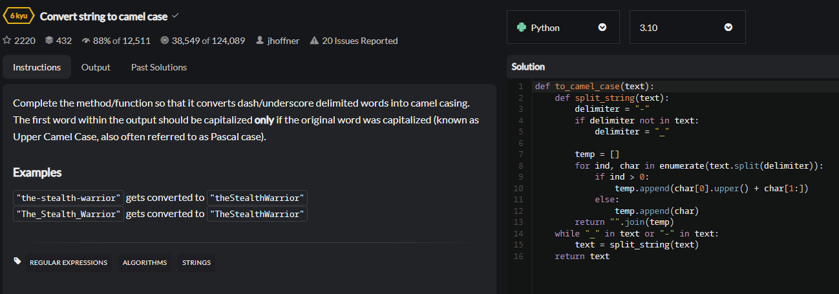
Resources for learning Python:
LinkedIn Learning – Python Quick Start:
https://www.linkedin.com/learning/python-quick-start/advance-your-career-with-python
October 20, 2022

Slide 43





Resources for learning Python:
Codewars: https://www.codewars.com/dashboard
October 20, 2022

Slide 44
Contact Information:
GitHub: https://github.com/DaltonGOO
LinkedIn: https://www.linkedin.com/in/dalton-goodwin-067a07107/
YouTube: https://www.youtube.com/c/TheBIMCoordinator/featured
October 20, 2022
Notes:
This was to support a longer term of getting people into projects
Ensure system is fully closed
CFM filled in on all diffusers
Cap all open ends
Show disconnects
Check duct systems
As air moves through a duct the air closest to the duct moves slower than air in middle of the duct due to friction. The friction impacts a static pressure drop that a fan needs to overcome to move air through the duct. We can calculate that pressure drop by knowing the air flow, the dimensions of the duct and the length of the duct run at that size. Every elbow, transition, takeoff, or other fitting on a duct run will also have a static pressure impact. We utilize formulas within a design standard (SMACNA) to help us determine what that static pressure value is.
Fans use electrical power to create a pressure differential across themselves (potential energy). This pressure differential causes air to flow down a duct (kinetic energy). As air travels down the duct obstructions will cause turbulence. Also, air moving against the inside of the duct will create friction. Both effects cause the available pressure (potential energy) to be reduced. This reduction in available pressure is called a “pressure drop” and we can calculate how much pressure is lost from each obstruction, transition, elbow, etc.

Slide 45
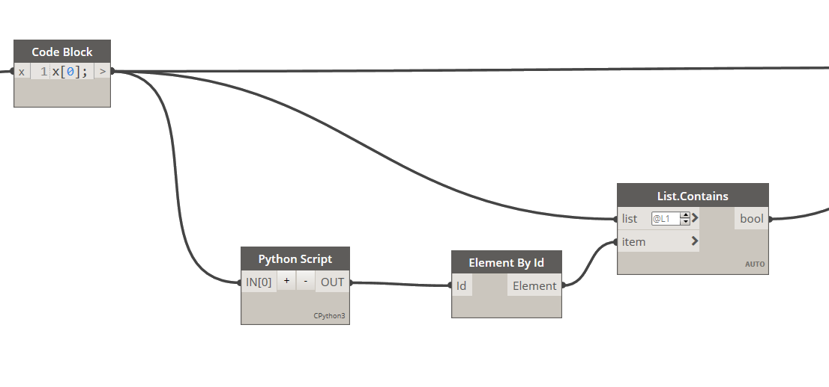
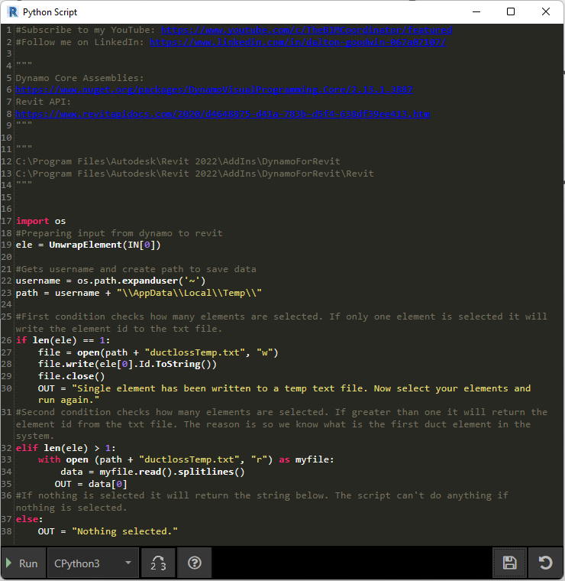

Slide 46
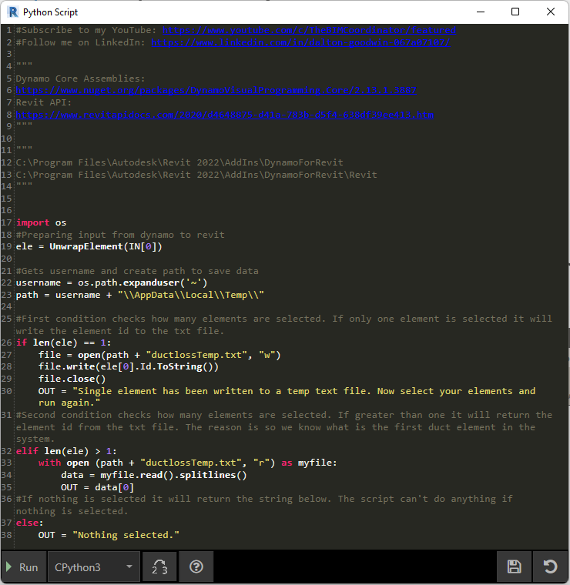

Slide 49
Conditional Statements

Slide 53
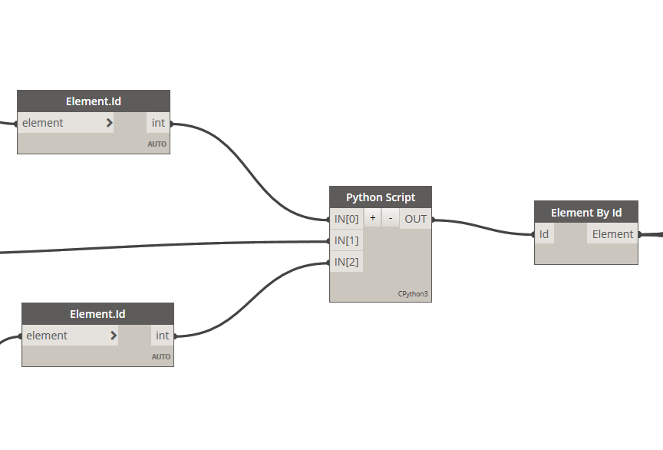
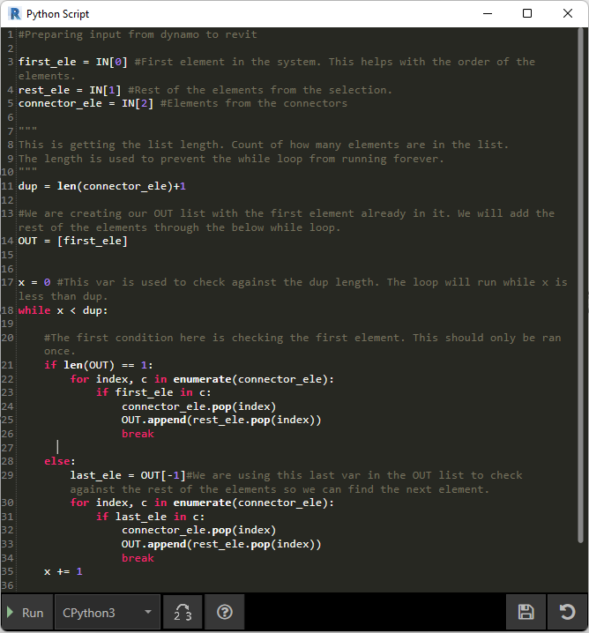

Slide 55
